Slide 1
Relationship in Java

Slide 2
Relationship
Type of relationship always makes to understand how to reuse the feature from one class to another class.
Based on reusing the data members from one class to another class in JAVA we have three types of relationships.
They are
Is-A Relationship
Has-A Relationship
Uses-A Relationship

Slide 3
Relationship
Is-a relationship is one in which data members of one class is obtained into another class through the concept of inheritance.
Has-a relationship is one in which an object of one class is created as a data member in another class.
Uses-a relationship is one in which a method of one class is using an object of another class.

Slide 4
Inheritance
Inheritance is the technique which allows us to inherit the data members and methods from base class to derived class.
Base class is one which always gives its features to derived classes.
Derived class is one which always takes features from base class.
A Derived class is one which contains some of features of its own plus some of the data members from base class

Slide 5
Is-A relationship
In Is-A relationship one class is obtaining the features of another class by using inheritance concept with extends keywords.
In a IS-A relationship there exists logical memory space.
This refers to inheritance or implementation.
Expressed using keyword “extends”.
Main advantage is code reusability.

Slide 6
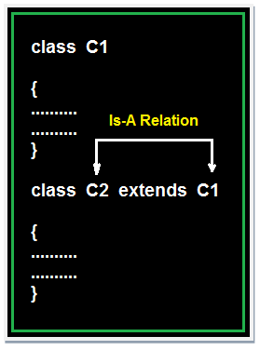
Syntax for Inheriting the features from base class to derived class:
class<clsname-2>extends<clsname-1>
{
Variable declaration;
Method definition;
};

Slide 7
Example of Is-A Relation
class Faculty
{
float salary=30000;
}
class Science extends Faculty
{
float bonus=2000;
public static void main(String args[])
{
Science obj=new Science(); System.out.println("Salary is:"+obj.salary); System.out.println("Bonus is:"+obj.bonus);
}
}
Output:
Salary is: 30000.0
Bonus is: 2000.0

Slide 8
HAS-A Relationship
Has-A means an instance of one class “has a” reference to an instance of another class or another instance of same class.
It is also known as “composition” or “aggregation”.
There is no specific keyword to implement HAS-A relationship but mostly we are depended upon “new” keyword.

Slide 9
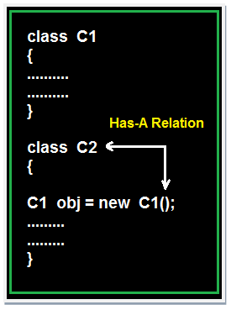
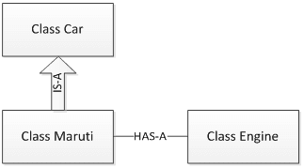
Composition(HAS-A) simply mean the use of instance variables that are references to other objects. For example Maruti has Engine, or House has Bathroom.
Let’s understand these concepts with an example of Car class.

Slide 10
package relationships; class Car
{
// Methods implementation and class
//Instance members private String color;
private int maxSpeed;
public void carInfo()
{
System.out.println("Car Color= "+color + " Max Speed= " + maxSpeed);
}
public void setColor(String color)
{
this.color = color;
}
public void setMaxSpeed(int maxSpeed)
{
this.maxSpeed = maxSpeed;
}
}

Slide 11
As shown above, Car class has a couple of instance variable and few methods. Maruti is a specific type of Car which extends Car class means Maruti IS-A Car.
class Maruti extends Car
{
//Maruti extends Car and thus inherits all methods from Car (except final and static)
//Maruti can also define all its specific functionality public void MarutiStartDemo()
{
Engine MarutiEngine = new Engine(); MarutiEngine.start();
}
}

Slide 12
package relationships; public class Engine
{
public void start()
{ System.out.println("Engine Started:");
}
public void stop()
{ System.out.println("Engine Stopped:");
}
}
Maruti class uses Engine object’s start() method via composition. We can say that Maruti class HAS-A Engine.

Slide 13
Relations Demo class is making object of Maruti class and initialized it.
Though Maruti class does not have setColor(), setMaxSpeed() and carInfo() methods still we can use it due to IS-A relationship of Maruti class with Car class.

Slide 14
package relationships;
public class RelationsDemo
{
public static void main(String[] args)
{
Maruti myMaruti = new Maruti();
myMaruti.setColor("RED");
myMaruti.setMaxSpeed(180);
myMaruti.carInfo();
myMaruti.MarutiStartDemo();
}
}

Slide 15
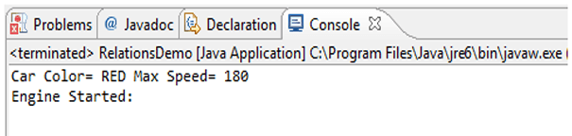
If we run Relations Demo class we can see output like below.

Slide 16
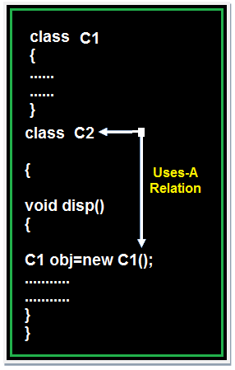
Uses-A relationship
A method of one class is using an object of another class the relationship between these two classes is known as Uses-A relationship.

Slide 17
Uses-A relationship
As long as the method is execution the object space (o1) exists and once the method execution is completed automatically object memory space will be destroyed.

Slide 18
Example of Uses-A Relation
class Employee
{
float salary=30000;
}
class Salary extends Employee
{
void disp()
{
float bonous=1000; Employee obj=new Employee();
float Total=obj.salary+bonous;
System.out.println("Total Salary is:"+Total);
}
}
class Developer
{
public static void main(String args[])
{
Salary s=new Salary(); s.disp();
}
}
output :
Total Salary is: 31000.0

Slide 19
Notes
Note 1: The default relationship in java is Is-A because for each and every class in java there exist an implicit predefined super class is java.lang.Object.
Note 2: The universal example for Has-A relationship is System.out (in System.out statement, out is an object of printStream class created as static data member in another system class and printStream class is known as Has-A relationship).
Note 3: Every execution logic method (main()) of execution logic is making use of an object of business logic class and business logic class is known as Uses-A relationship.

Slide 20
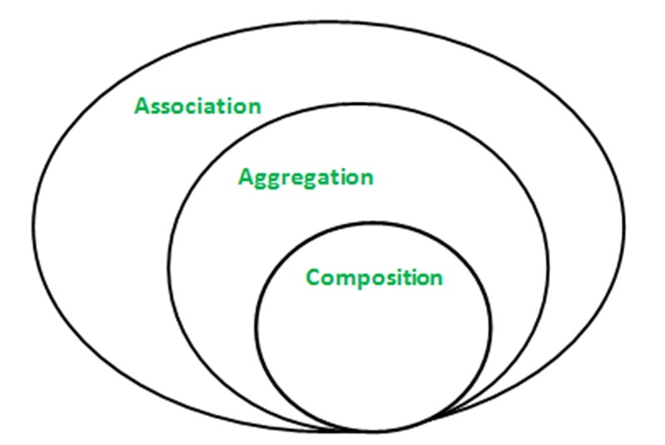
Association, Composition and Aggregation in Java
Association is relation between two separate classes which establishes through their Objects. Association can be one-to-one, one-to-many, many-to-one, many-to-many.
In Object-Oriented programming, an Object communicates to other Object to use functionality and services provided by that object. Composition and Aggregation are the two forms of association.

Slide 21
Java program to illustrate the concept of Association
// class bank
class Bank
{
private String name;
// bank name
Bank(String name)
{
this.name = name;
}
public String getBankName()
{
return this.name;
}
}
// employee class
class Employee
{
private String name;
// employee name
Employee(String name)
{
this.name = name;
}
public String getEmployeeName()
{
return this.name;
}
}

Slide 22
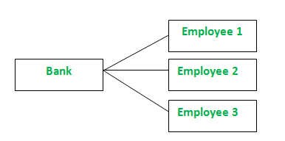
// Association between both the
// classes in main method
class Association
{
public static void main (String[] args)
{
Bank bank = new Bank("Axis");
Employee emp = new Employee("Neha");
System.out.println(emp.getEmployeeName() +
" is employee of " + bank.getBankName());
}
}
Output
Neha is employee of Axis
In above example two separate classes Bank and Employee are associated through their Objects. Bank can have many employees, So it is a one-to-many relationship.

Slide 23
Aggregation
t is a special form of Association where:
It represents Has-A relationship.
It is a unidirectional association i.e. a one way relationship. For example, department can have students but vice versa is not possible and thus unidirectional in nature.
In Aggregation, both the entries can survive individually which means ending one entity will not effect the other entity

Slide 24
Example
/ Java program to illustrate
//the concept of Aggregation.
import java.io.*;
import java.util.*;
// student class
class Student
{
String name;
int id ;
String dept;
Student(String name, int id, String dept)
{
this.name = name;
this.id = id;
this.dept = dept;
}
}

Slide 25
/* Department class contains list of student
Objects. It is associated with student
class through its Object(s). */
class Department
{
String name;
private List<Student> students;
Department(String name, List<Student> students)
{
this.name = name;
this.students = students;
}
public List<Student> getStudents()
{
return students;
}
}

Slide 26
/* Institute class contains list of Department
Objects. It is asoociated with Department
class through its Object(s).*/
class Institute
{
String instituteName;
private List<Department> departments;
Institute(String instituteName,
List<Department> departments)
{
this.instituteName = instituteName;
this.departments = departments;
}
// count total students of all departments in a given institute

Slide 27
public int getTotalStudentsInInstitute()
{
int noOfStudents = 0;
List<Student> students;
for(Department dept : departments)
{
students = dept.getStudents();
for(Students : students)
{
noOfStudents++;
}
}
return noOfStudents;
}
}

Slide 28
// main method
class GFG
{
public static void main (String[] args)
{
Student s1 = new Student("Mia", 1, "CSE");
Student s2 = new Student("Priya", 2, "CSE");
Student s3 = new Student("John", 1, "EE");
Student s4 = new Student("Rahul", 2, "EE");

Slide 29
// making a List of CSE Students.
List <Student> cse_students = new ArrayList<Student>();
cse_students.add(s1);
cse_students.add(s2);
// making a List of EE Students
List <Student> ee_students = new ArrayList<Student>();
ee_students.add(s3);
ee_students.add(s4);
Department CSE = new Department("CSE", cse_students);
Department EE = new Department("EE", ee_students);

Slide 30
List <Department> departments = new ArrayList<Department>();
departments.add(CSE);
departments.add(EE);
// creating an instance of Institute.
Institute institute = new Institute("BITS", departments);
System.out.print("Total students in institute: ");
System.out.print(institute.getTotalStudentsInInstitute());
}
} output: Total students in institute: 4

Slide 31
In this example, there is an Institute which has no. of departments like CSE, EE. Every department has no. of students. So, we make a Institute class which has a reference to Object or no. of Objects (i.e. List of Objects) of the Department class. That means Institute class is associated with Department class through its Object(s) and Department class has also a reference to Object or Objects (i.e. List of Objects) of Student class means it is associated with Student class through its Object(s).
It represents a Has-A relationship.

Slide 32
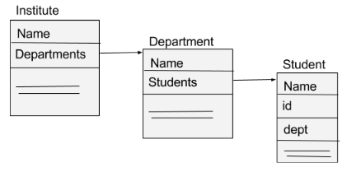
When do we use Aggregation ?? Code reuse is best achieved by aggregation.

Slide 33
Composition
Composition is a restricted form of Aggregation in which two entities are highly dependent on each other.
It represents part-of relationship.
In composition, both the entities are dependent on each other.
When there is a composition between two entities, the composed object cannot exist without the other entity.

Slide 34
Lets take example of Library.
// Java program to illustrate
// the concept of Composition
import java.io.*;
import java.util.*;
// class book
class Book
{
public String title;
public String author;
Book(String title, String author)
{
this.title = title;
this.author = author;
}
}
// Libary class contains
// list of books.
class Library
{

Slide 35
// reference to refer to list of books.
private final List<Book> books;
Library (List<Book> books)
{
this.books = books;
}
public List<Book> getTotalBooksInLibrary(){
return books;
}
}
/ main method
class GFG
{
public static void main (String[] args)
{
// Creating the Objects of Book class.
Book b1 = new Book("EffectiveJ Java", "Joshua Bloch");
Book b2 = new Book("Thinking in Java", "Bruce Eckel");
Book b3 = new Book("Java: The Complete Reference", "Herbert Schildt");

Slide 36
// Creating the list which contains the no. of books.
List<Book> books = new ArrayList<Book>();
books.add(b1);
books.add(b2);
books.add(b3);
Library library = new Library(books);
List<Book> bks = library.getTotalBooksInLibrary();
for(Book bk : bks){
System.out.println("Title : " + bk.title + " and "
+" Author : " + bk.author);
}
}
}

Slide 37
Output :
Title : EffectiveJ Java and Author : Joshua Bloch Title : Thinking in Java and Author : Bruce Eckel Title : Java: The Complete Reference and Author : Herbert Schildt

Slide 38
Aggregation vs Composition
Dependency: Aggregation implies a relationship where the child can exist independently of the parent. For example, Bank and Employee, delete the Bank and the Employee still exist. whereas Composition implies a relationship where the child cannot exist independent of the parent. Example: Human and heart, heart don’t exist separate to a Human
Type of Relationship: Aggregation relation is “has-a” and composition is “part-of” relation.
Type of association: Composition is a strong Association whereas Aggregation is a weak Association.

Slide 39
End of Session - 8 Thank You !

